Slide 1
2.3 Decimal Fractions
18
Fractions do not necessarily have exact representations in all bases, i.e., with a fixed number of digits.
In base 10, if the denominator contains powers of 2 and/or 5, the fraction can be exactly represented.

Slide 2
2.3 Decimal Fractions
18a
So here are some that can be exactly represented:
1/2 = .5 1/4 = .25
1/5 = .2 1/25 = .04
1/10 = .1 1/100 = .01 (because 10 = 2*5)
1/20 = .05 (because 20 = 2*2*5)
1/50 = .02 (because 50 = 2*5*5)

Slide 3
2.3 Decimal Fractions
18b
And here are some that can’t:
1/3 = .333333... 1/30 = .033333...
4/30 = 2/15 = .1333.. 13/99 = .13131313...
If a fraction cannot be exactly represented, it can always be represented by a fixed part plus a repeating part
Each part can have one or more digits.

Slide 4
2.3 Binary Fractions
18c
In binary, only sums of powers of 2 can be exactly represented.
Here are some examples:
1/2 = 0b.1
1/4 = 0b.01
1/8 = 0b.001
3/4 = 1/2 + 1/4 = 0b.11
1/2²⁰ = 0b.00000000000000000001

Slide 5
2.3 Binary Fractions
18d
And here are some fractions that can’t be exactly represented:
1/3 = 0b.010101...
1/12 = 0b.00010101...
1/5 = 0b.00110011...
1/10 = 0b.000110011...
Again, there is a repeating part, possibly preceded by a non-repeating part.

Slide 6
2.3 Truncation Error
18e
The fact that most fractions can’t be exactly represented in a given number of bits is extremely important in computer science.
But whether this is because the binary representation is infinite or just needs a large number of bits like 1/2²⁰ is not important to us, only to mathematicians.

Slide 7
2.3 Truncation Error
18f
Since any field has a finite width, we need to round off or truncate after that width is reached.
Usually we truncate, since that is easier for computer systems to do.
That means that binary fractions are dangerous for representing money, for example, where we need an exact representation.
For non-financial systems, we generally just need to know what the maximum possible error is.

Slide 8
2.3 Fractional Representation
19
Digits to the right of the radix point represent negative powers of the radix.
The radix point is called the decimal point or binary point in decimal and binary, respectively.
  0.47₁₀ = 4 × 10 ⁻¹ + 7 × 10 ⁻²
  0.11₂ = 1 × 2 ⁻¹ + 1 × 2 ⁻²
  = ½ + ¼
  = 0.5 + 0.25 = 0.75

Slide 9
2.3 Decimal Fract to Bin (Sub.)
20
For converting decimal fractions to binary, there is a subtraction method and a multiplication method.
The subtraction method for fractions is identical to the subtraction method for integers. Instead of subtracting positive powers of 2, we subtract negative powers of 2.
We always start with the largest value first, 2 ⁻¹, which is .5. Then we subtract 2 ⁻², which is .25, etc.

Slide 10
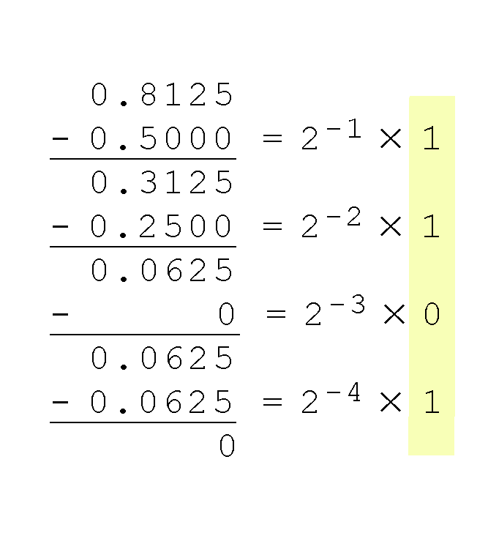
2.3 Decimal Fract to Bin (Sub.)
21
In this example, we convert 0.8125 to binary.
  We subtract 1/2, 1/4...
  If the number is too small to subtract that fraction, that bit becomes 0.
  Our result, reading from top to bottom is:
  0.8125₁₀ = 0.1101₂

Slide 11
2.3 Decimal Fract to Bin (Sub.)
21b
  We stop when we reach 0, or when we reach the desired number of bits.
  For example, if we were converting .8126 to a binary number with a width of 4 bits, we’d still get 0b.1101, with an error term of .0001₁₀ (because there would be a 1 instead of a 0 at the end.)

Slide 12
2.3 Decimal Fract to Bin (Sub.)
21c
The subtraction method is not always convenient because it requires a table of negative powers of 2: .5, .25, etc.
Learn these:
  2⁻¹ = 1/2 = .5
  2⁻² = 1/4 = .25
  2⁻³ = 1/8 = .125
  2⁻⁴ = 1/16 = .0625

Slide 13
2.3 Decimal Fract to Bin (Sub.)
20d
To know the number of output bits, you must look at the desired output data structure
  Number of bits requested to the right of the point is often required to be a multiple of 2, 4 (nibble) or 8 (byte).
  You can add as many 0’s to the right as desired.

Slide 14
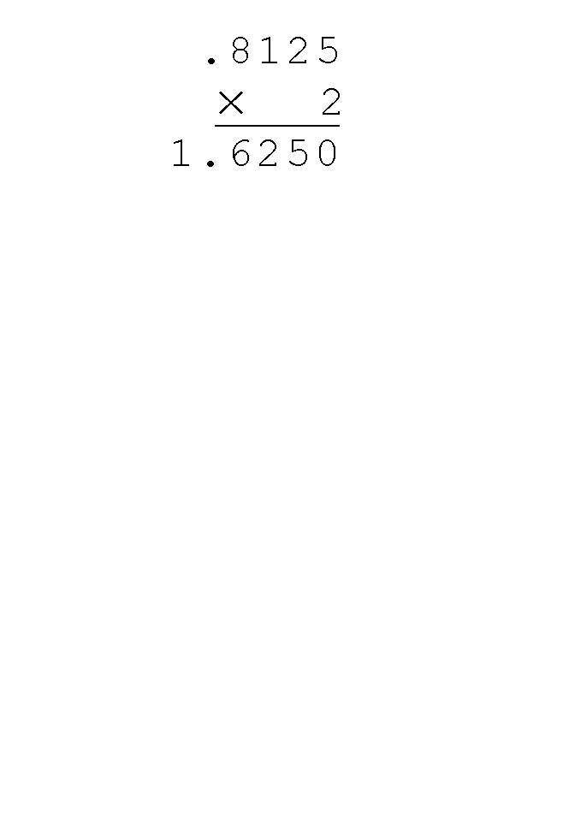
2.3 Decimal Fract to Bin (Mult.)
22
Using the multiplication method to convert the decimal 0.8125 to binary, we repeated multiply by 2.
Whenever we get a part that’s no longer a fraction (like the 1 in the example), we have finished converting that part, so we drop it from our calculation and save it for the binary result (see next slide).

Slide 15
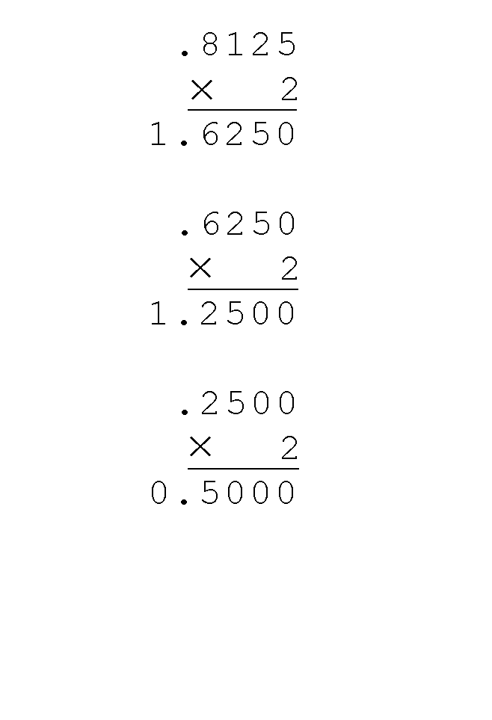
2.3 Decimal Fract to Bin (Mult.)
23
Converting 0.8125 to binary . . .
  Ignoring the value in the units place at each step, continue multiplying each fractional part by 2.
  We drop the 1, then multiply the remaining fraction (.6250) by 2.

Slide 16
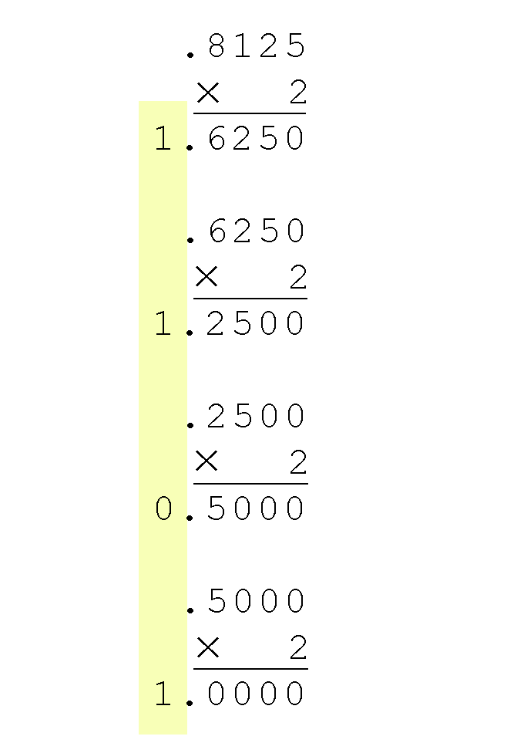
2.3 Decimal Fract to Bin (Mult.)
24
Converting 0.8125 to binary . . .
  We are finished when the remaining piece of the input is zero, as in this example, or until we have reached the desired number of binary places.
  Our result, reading from top to bottom is:
  0.8125₁₀ = 0.1101₂

Slide 17
2.3 Decimal Fraction to Hex
24a
To convert a decimal fraction to hex:
  Convert it to a binary fraction with the desired number of bits.
  Even if the conversion terminates earlier, fill out the binary fraction on the right with 0’s to a full number of bytes.
  Convert each nibble to hex.
Example: convert 7/8 to hex.
  7/8 = 0b.11100000 = 0x.e0.

Slide 18
2.3 Binary Fraction to Decimal
24b
Converting binary fractions to decimal is a
two-step process:
  Convert the binary number to the right of the point to decimal.
  Divide it by the appropriate power of 2.

Slide 19
2.3 Binary Fraction to Decimal
24c
Example: convert 0b.1101 to decimal.
  0b1101 = 13.
  There are four bits after the binary point, so the denominator is 2⁴.
  So the result is 13/2⁴ = 13/16.
If you need a decimal result, there are two ways to obtain it.
  By multiplying: 1/16 = .0625, so 13/16 = .8125.
  By division: divide 16 into 13.

Slide 20
2.3 Hex Fraction to Decimal
24d
Hex fractions can be converted to decimal in the same way.
Example: 0x.d1.
  0xd1 = 209
  16⁻² = 1/256
  So 0x.d1 = 209/256.
You can also convert the hex fraction to binary first.

Slide 21
2.b Binary <--> hex fractions
24e
Since 2⁴ = 16, the conversion happens at the nibble level (nibble = half byte = 4 bits)
For binary -> hex, that means we need full nibbles to do the conversion
  Generally we need full bytes
  So we fill out the binary fraction with 0’s to the right if necessary
  For hex to binary, we already have full nibbles (usually full bytes)
Example: 0x .20 = 0b .0010 0000

Slide 22
2.b Binary <--> hex fractions
24e
Convert data before and after the point separately, then add the two pieces
Example
  0x 0 a . 2 0
  0b 0000 1010 . 0010 0000

